Slide 1
Improving Survey Efficiency with Linked Data: The Survey of Doctorate Recipients Story
Wan-Ying Chang, Flora Lan, Kelly Phou, and Lynn Milan
August 6, 2024
Joint Statistical Meetings 2024; Portland, Oregon

Slide 2
Disclaimer
This presentation provides results of exploratory research by the National Center for Science and Engineering Statistics (NCSES) within the U.S. National Science Foundation (NSF). This information is shared to inform interested parties of ongoing activities and to encourage further discussion. Views expressed are those of the presenters and not necessarily those of NCSES or NSF.
This product has been reviewed for unauthorized disclosure of confidential information under NCSES-DRN24-028.

Slide 3
National Center for Science and Engineering Statistics Measuring America’s progress in science, technology, and innovation
Part of the National Science Foundation (NSF)
Located within the Directorate for Social, Behavioral, and Economic Sciences (SBE)
One of 13 principal federal statistical agencies
Overseen by the U.S. Chief Statistician within the White House Office of Management and Budget (OMB)
MISSION
Produce policy relevant, policy neutral statistical information on the U.S. science and engineering enterprise:
Research and development
Science and engineering workforce
U.S. competitiveness in STEM
STEM education in the United States

Slide 4
Outline
Survey design, operation, and efficiency
The journey to data linkage
Excitement and challenges at the start
Findings from linked data
Where are we now
Integrate data linkage into survey design

Slide 5
Life Cycle of a Federal Survey
Government Initiative & Design
Data Collection
Analysis & Dissemination
Information products: reports, data tables, data tools, microdata
Data user support
Outreach
Stakeholder input
Content design
Questionnaire design
Cognitive testing
Instrument building
Frame construction
Sample design
Contact protocol; incentive plan; adaptive design
Data entry; coding; editing; imputation of missing item
Nonresponse weighting adjustment; variance estimation

Slide 6
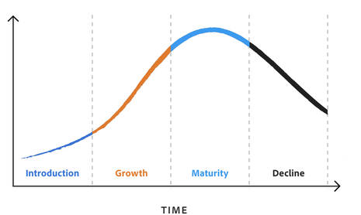
Improve Survey Efficiency: Follow the Well-Oiled Machine or Innovate?
Commercial product life cycle
Like commercial products, the value of a long-running survey may decrease over time. It is critical to build a process for timely updates of survey products to maintain its relevance.
Is the traditional data collection method still the most efficient choice?
VALUE

Slide 7
Data Linkage Is a New Design Option
Assuming high-quality data linkage is achievable, data linking becomes a new way of collecting data with benefits of the following:
Lowering survey cost
Reducing response burden
Avoiding reporting error
Including richer and more granular data
Acquiring more timely data
Directing survey design to collect data not available elsewhere

Slide 8
The Journey to Data Linkage

Slide 9
Survey of Doctorate Recipients (SDR)
Sample survey of individuals who earned a research doctorate from a U.S. institution in a science, engineering, or health (SEH) field and are less than 76 years of age
Features:
A biennial survey since 1973
Fixed panel plus birth sample design
Provides cross-sectional and longitudinal data
Sample is drawn from a census survey: the Survey of Earned Doctorates
The SDR collects demographic, education, and employment information from doctorate recipients
Sponsored by NCSES and the National Institutes of Health

Slide 10
SDR Core Topics and Special Modules
Demographics
Employment during reference date
- Employer type
- Occupation
- Work activities
- Faculty rank, tenure status
- Relation between job and degree
- Salary and earned income
Recent training, education
Postdocs
All postdoc positions
Professional activities
Presentations, articles, patents
Retirement experiences
Single-Cycle Modules

Slide 11









Data Linkage Efforts

Slide 12
Findings from Linked Data

Slide 13
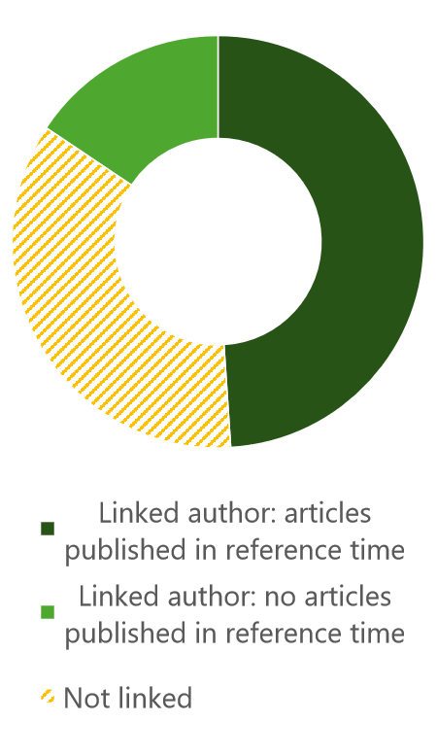
SDR Linked to Authors of Publications
Self-reported survey data compared with linked Scopus data
Note: The reference time for reporting publications is October 2003 – October 2008.

Slide 14
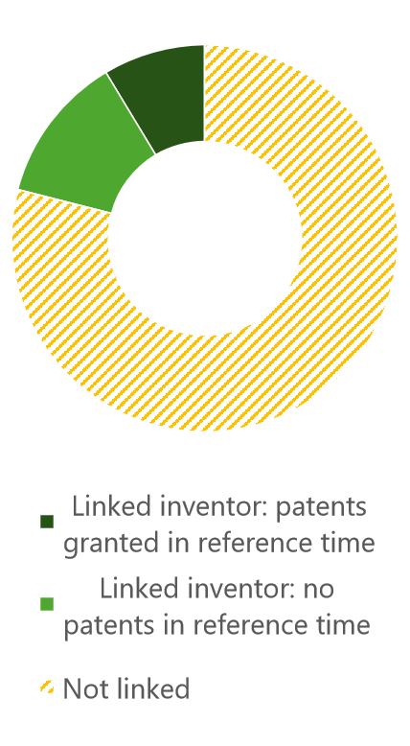
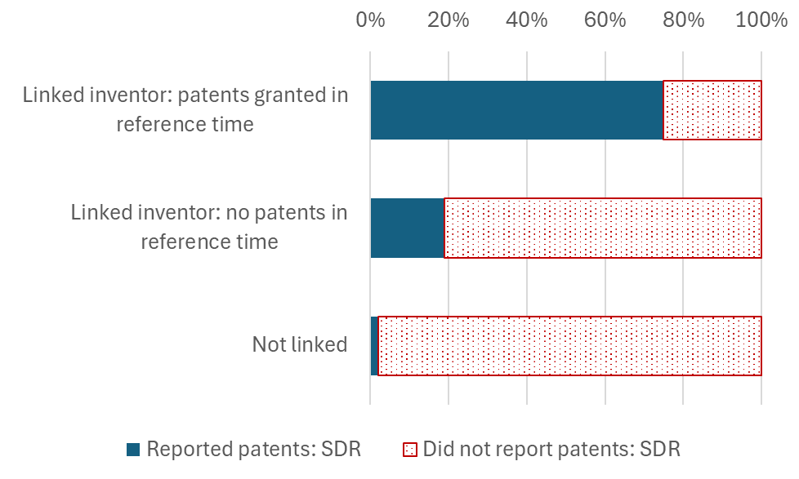
SDR Linked to Inventors in PatentsView
Self-reported survey data compared with linked PatentsView data
Note: The reference time for reporting patents is October 2003 – October 2008.
Notes:
.

Slide 15
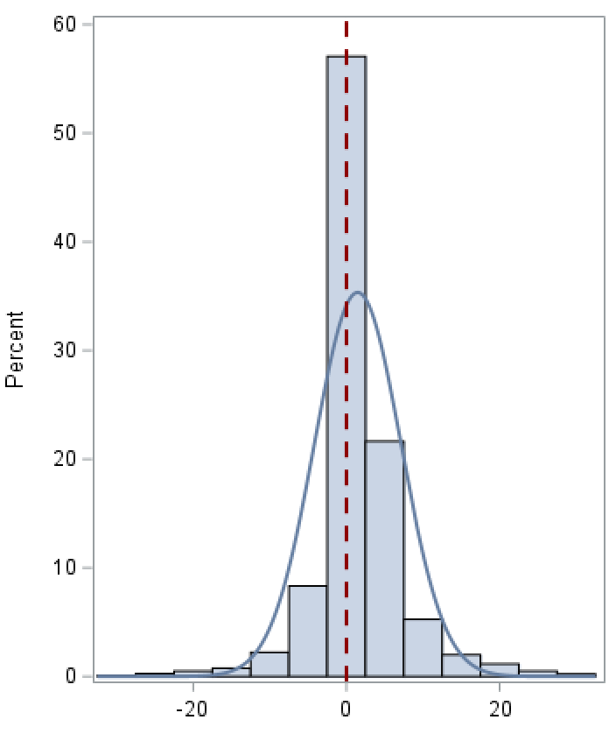
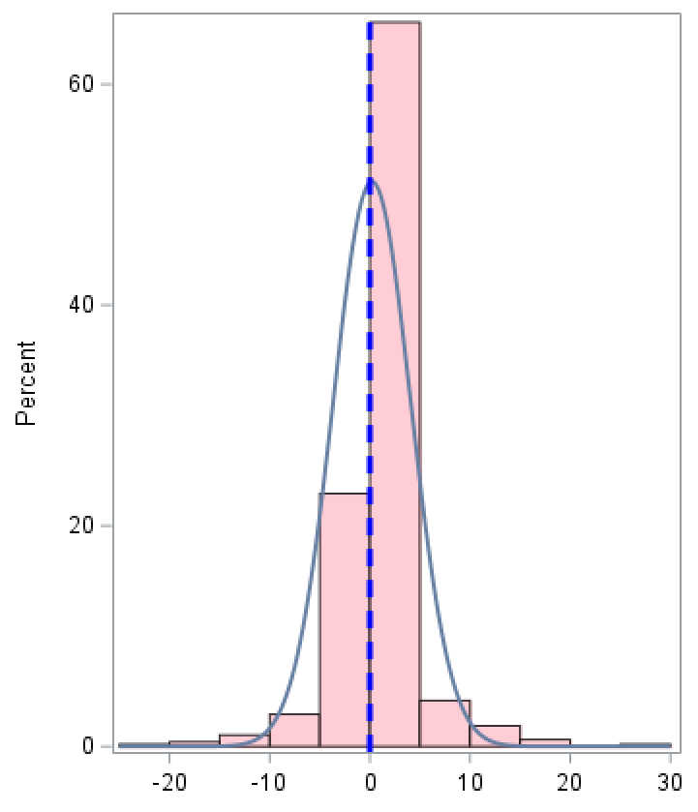
Evidence of Survey Recall Bias
Substantial recall biases are observed for reporting count of publications or count of granted patents over a 5-year period prior to the survey reference time.
Article count difference (SDR – Scopus)
Patent count difference (SDR – PatentsView)

Slide 16
With All Caveats, the Picture Is Still Rosy
To measure impact of research funding on scientific activities and innovation output of the U.S.-trained SEH PhDs, longitudinal data must be acquired. These data are challenging and costly to collect by surveys.
Bibliometric data offers longitudinal information on field of research, research affiliations, collaborators, and citations and related impact measures. Text analysis of the abstracts or full-text publications further increases the potential of the linked data.
Patent data includes longitudinal information on patenting fields, assignees, coinventors, and funding information. Connecting these critical information with data of inventor’s background and educational history from the survey offers unique sources for studying the pathway to invention.

Slide 17
Integrate Data Linkage into Survey Design

Slide 18
Data Linkage Is a New Design Option
Assuming high-quality data linkage is achievable, data linking becomes a new way of collecting data.
To support linkage, what can be planned in survey operation?
Collect and maintain high-quality data of respondents to support linkage
Collect gold standard data for linkage evaluation
Adjust survey design to support linkage

Slide 19
Data Linkage Is a Complex R&D Journey
Research Initiative
Data Linking & Evaluation
Production & Analysis
Linked data ownership and access management
Research data: design and production
User support and outreach
New data products: design and production
Continuing research and development
Research proposals
Determine source data and availability
Assess feasibility
Data use agreements
Secure data facility
Develop linkage methods
Pre-linkage data processing
Linkage criteria and rules
Evaluate linkage results

Slide 20
Extend Statistical Practices to Linked Data
Nonresponse bias weighting adjustment
Imputation for records with less certain link status
Data quality measures
Incorporate linkage errors into total survey errors
Measures of fitness for use

Slide 21
Planning for Production and Analysis
Include data product plan at early-stage planning
Design data product and use cases with data limitation in mind
Build a user-data developer feedback loop
Support continuing research

Slide 22
Thank you!

Slide 23
Contact
Wan-Ying Chang wchang@nsf.gov

